Slide 1


KRAKEN QGIS PLUGIN • USER MANUAL
PCI Conflict Checker
Automated spatial overlapping sector detection for identical Physical Cell IDs (PCI) and Modulo collisions across RAN network layers.
Analysis Type
Spatial Engine
Output Visual
PCI & Modulo 3/6/30
Pie Wedge & R-Tree
Polygons & Ray Lines
Kraken © 2026 | akanipatra@gmail.com

Slide 2

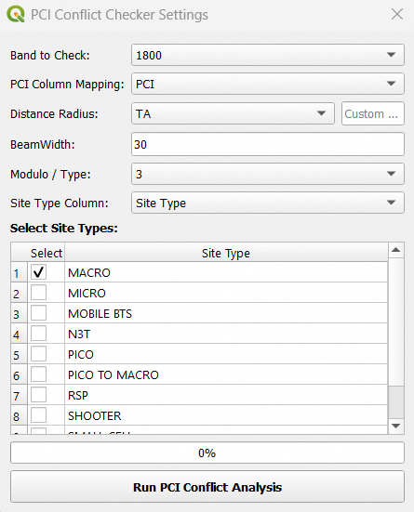
STEP 01 • INPUT CONFIGURATION
PARAMETER & MAPPING SETTINGS
Configure cell layer fields, spatial coverage radius, and select target site types.
01
Frequency Band & PCI Column
Select targeted frequency band (e.g. 1800) and map PCI attribute column from active GCELL layer.
02
Distance Radius & Beamwidth
Specify dynamic radius column (e.g. TA) or manual custom distance. Default horizontal Beamwidth is set to 30°.
03
Site Type Filter Table
Toggle site categories (MACRO, MICRO, PICO, etc.) to include or exclude specific network nodes from detection.
Kraken © 2026 | akanipatra@gmail.com

Slide 3
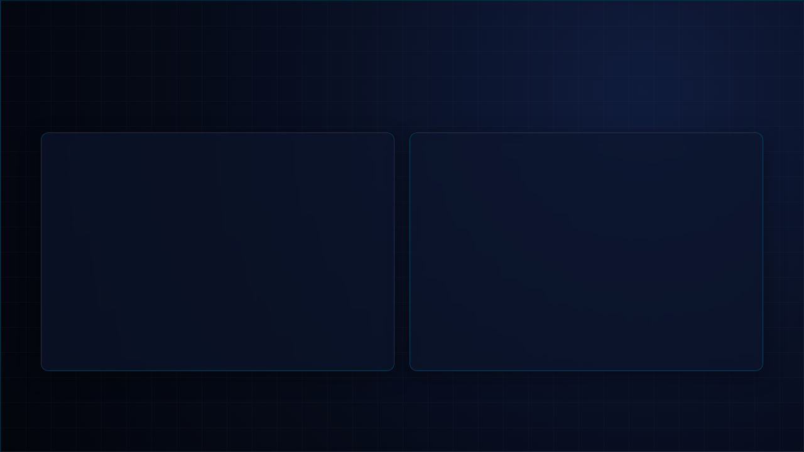
STEP 02 • ALGORITHMIC ENGINE
DETECTION MODULO & CALCULATION
Understand collision math and spatial pie wedge intersection geometry.
MODULO MODES
GEOMETRY MODEL
Conflict Logic Rule
Pie Wedge Generation
Algorithm screens candidate pairs in current map canvas extent matching specified collision criteria:
Synthesizes realistic directional sector wedges based on site coordinates, azimuth, and radius.
•
Same PCI: Direct identical PCI ID collision ( ).
Geographic Correction: Auto converts meters to degrees using latitude scale factors.
•
•
Mod 3: PSS (Primary Sync Signal) collision.
•
Mod 6: RS (Reference Signal) pilot pollution.
Polygon Intersection: Computes exact spatial overlap geometry ( ).
•
•
Mod 30: Pattern grouping conflict.
•
Area Filtering: Filters out zero-area point/line touches.
Fast spatial indexing using QgsSpatialIndex (R-Tree) for instant spatial lookup.
Handles both geographic (WGS84) and projected coordinate reference systems.
Kraken © 2026 | akanipatra@gmail.com

Slide 4
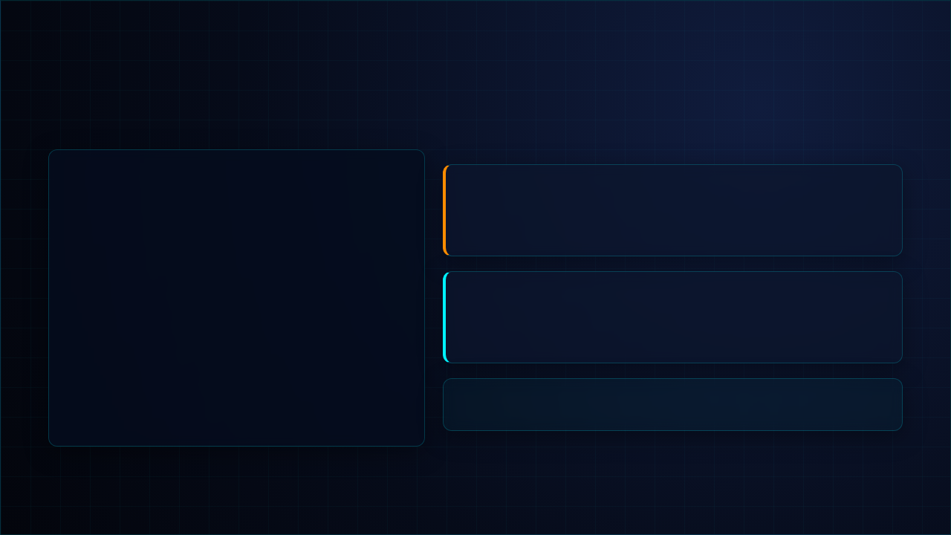

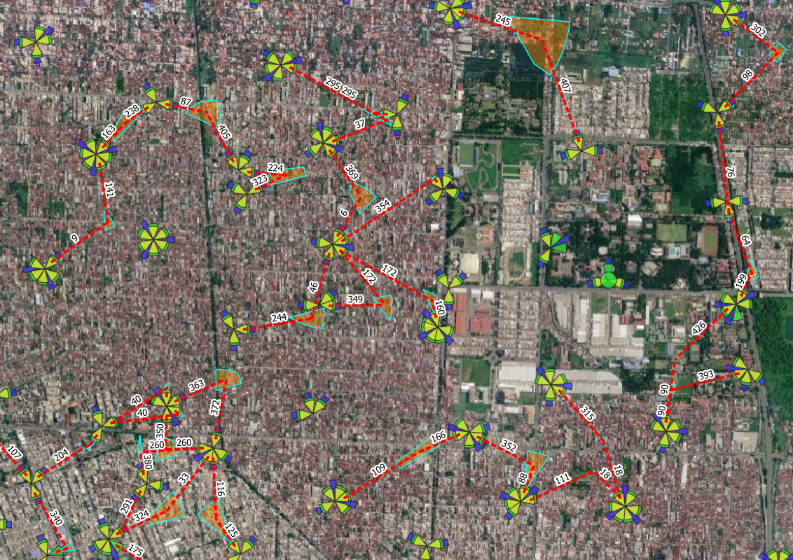
STEP 03 • SPATIAL GIS REPRESENTATION
GIS OUTPUT LAYERS & VISUALS
Automatically rendered conflict layers directly added into QGIS project map canvas.
1. PCI Conflict Areas Layer
Polygon Layer
Orange semi-transparent polygon shapes representing overlapping coverage zones where PCI or Modulo collisions physically occur.
2. PCI Conflict Lines Layer
Line Layer
Dotted red connector lines linking serving cell site centroids directly to the conflict zone centroid with automated inline PCI label tags.
Attribute Table Data: Layers store detailed metadata including Cell A/B IDs, Cell Names, PCIs, Band, and Modulo values.
Kraken © 2026 | akanipatra@gmail.com

Slide 5
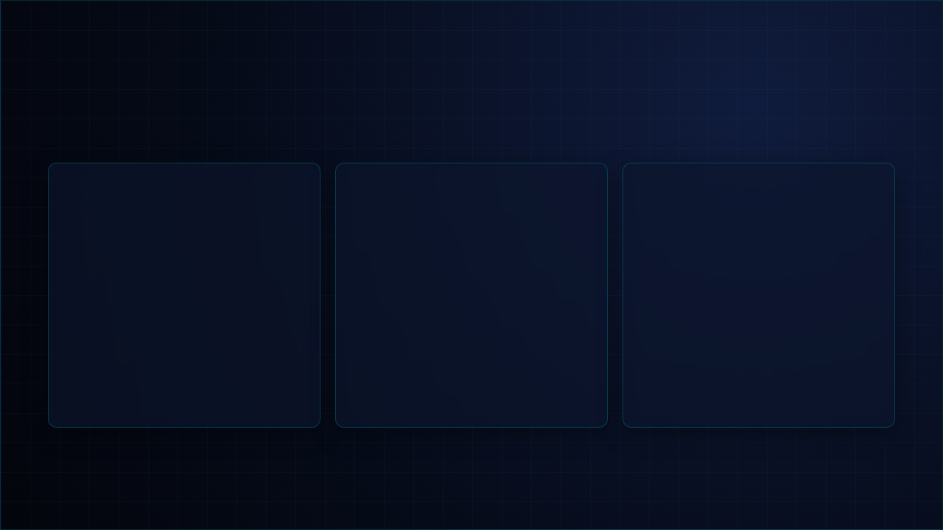



STEP 04 • BEST PRACTICES
EXECUTION & RECOMMENDATIONS
Key operational tips for optimal performance and accurate RAN optimization audits.
Map Canvas Extent
Dynamic vs Custom Radius
Auto Memory & Persistence
Analysis operates strictly on features within current map canvas bounds for maximum calculation speed. Zoom to cluster area before running.
Use TA distance mapping for realistic coverage bounds. Apply fixed Custom Radius (e.g. 1000m) when TA distance field is unavailable.
All dropdown mappings and unchecked site types are automatically saved to QSettings for seamless re-analysis in future sessions.
SPATIAL FILTER
RADIUS OPTION
SETTINGS MEMORY
Kraken © 2026 | akanipatra@gmail.com

